Slide 1
The University of Queensland
School of Earth and Environmental Sciences
Application of Finite Elements in
Geophysical Modelling
Lutz Gross
E-mail : l.gross@uq.edu.au

Slide 2
Outline
Derive a generic PDE form → `PDE Template`
How does this work apply in some geophysical application?
Solution using the Finite Element Method (FEM)

Slide 3
PDE Template
Generic from of a PDE with coefficient as parameters
  framework to derive FEM
  useful for development of software
Problem: overhead & efficience vs. flexibility
See also esys-escript for a more general form: https://github.com/esys-escript/esys-escript.github.io/blob/master/user.pdf

Slide 4




PDE Template
Potential u
Gravity force
Gauss’ Law
Unknown u
Pseudo flux F:
`Conservation` Law

Slide 5
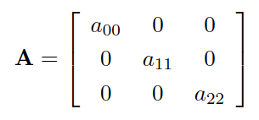

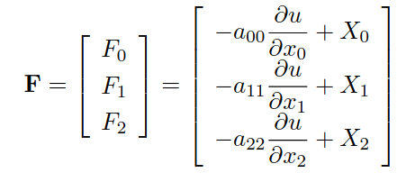
3D Case
Assume A as a diagonal matrix:

Slide 6


3D Case (cont.)
Conservation condition:

Slide 7

PDE Template for Gravity
For the gravity case:

Slide 8


Formulation of PDE:
Insert Flux into Conservation condition:
In 2D:

Slide 9



Boundary conditions
Dirichlet-type boundary conditions on Γ_{D}
  Γ_{D} = top of the domain Ω
Neumann-type boundary conditions on Γ_{N}
  With outer normal field n
  Γ_{N} = all other faces of the domain Ω

Slide 10
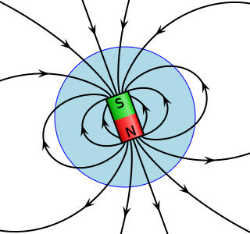


Magnetic Anomalies
Magnetic Flux B_{f}
  Total magnetic field B_{t}
    Background magnetic field B_{b}
    Magnetic field anomaly B_{a}
Magnetization M = k B_{b} with susceptibility k
  Here: linearized model, also possible M = k B_{t}

Slide 11

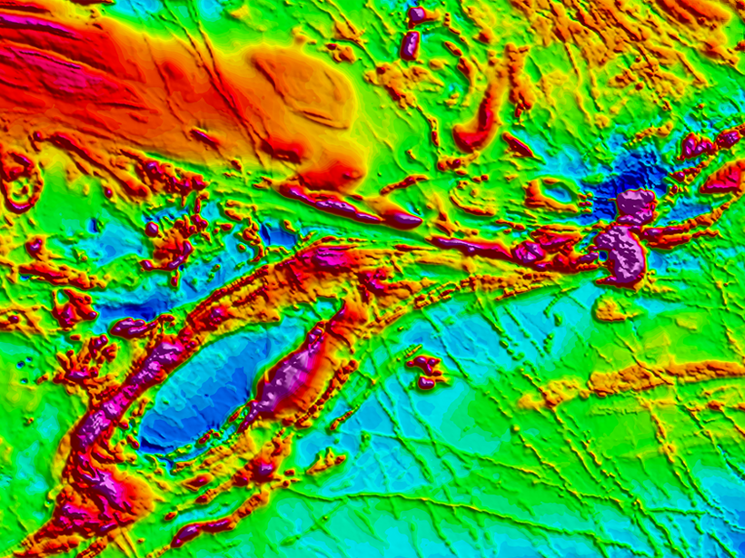
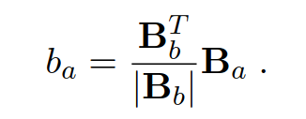
Magnetic Anomalies (cont.)
Observed is total magnetic field anomaly b_{a} is the difference of the intensity of the total magnetic field B_{t} and of the background field B_{b}:
With Linearization
Task: calculate magnetic field anomaly B_{a} from subsurface susceptibility k

Slide 12





Towards a PDE
magnetic flux B_{f} is divergence free:
With definition of B_{f}:
Analogously to gravity: scalar potential u with
Leading to PDE

Slide 13


Using the PDE template
pseudo flux F = B_{f}-B_{b}
Also: D=0, Y=0:
Neumann Boundary conditions:

Slide 14
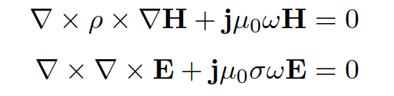
Magnetotellurics
Maxwell’s equations for
  magnetic field H
  electric field E
  Conductivity σ , resistivity ρ (σρ=1)
    Conductivity in air layer σ=0
  Angular frequency ω
  magnetic permeability μ₀

Slide 15
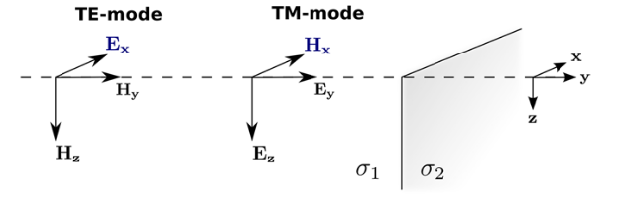
2D Model
no variation along the strike = x-direction
incoming wave fronts:
  transverse electric (TE) along Ex
    E_{y} = E_{z}=0, H_{x}=0
  transverse magnetic (TM) along Hx
    H_{x} = H_{z}=0, E_{x}=0

Slide 16

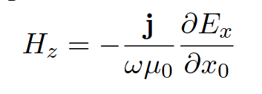
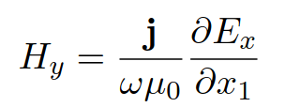
TE mode
Maxwell equation simplifies to
Recover magnetic field component:
Dirichlet boundary conditions
  Set as E_{x} from ‘air plus homogeneous subsurface‘

Slide 17


PDE Template: TE mode

Slide 18

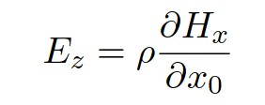
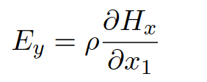
TM mode
Maxwell equation simplifies to
  No air-layer required as ρ=∞ → H_{x}=const
Recover magnetic field component:
Dirichlet boundary conditions
  Set as H_{x} from ‘homogeneous subsurface‘

Slide 19


PDE Template: TM mode

Slide 20
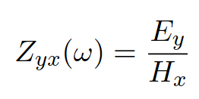
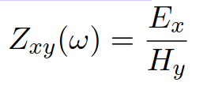
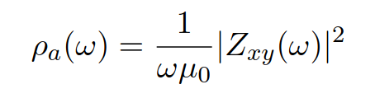
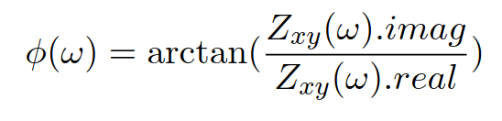
Impedance
Defined as
Expressed on term of apparent resistivity and phase:

Slide 21
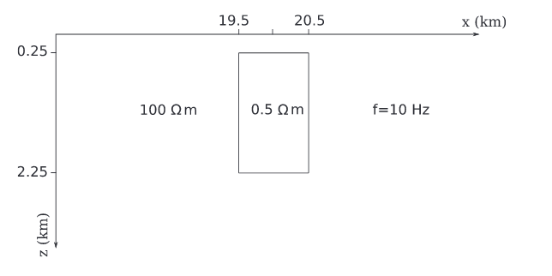
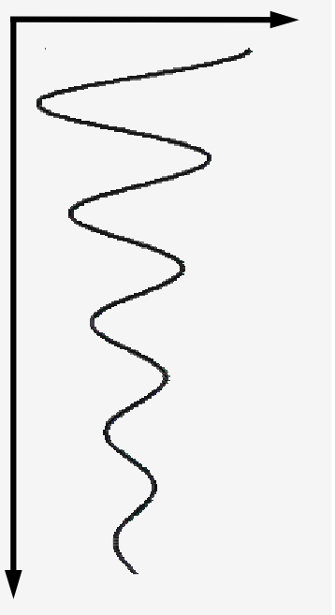
FEM solution
  Test case: See https://doi.org/10.1088/1742-2132/13/2/S59
Right face:
Dirichlet BC
Left face:
Dirichlet BC
Air layer σ=0
background
anomaly

Slide 22
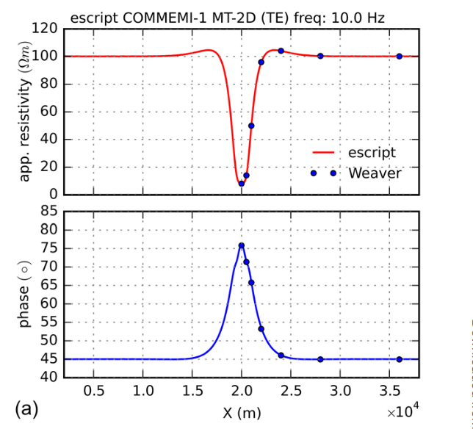
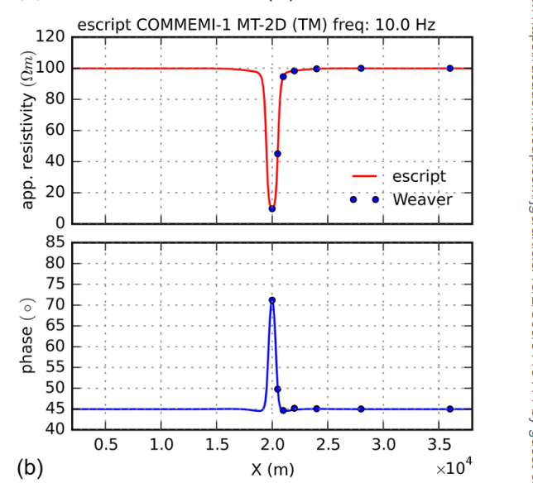
Result TE mode
FEM with 60000 nodes
  solved with esys-escript in python
Weaver – reference solution

Slide 23
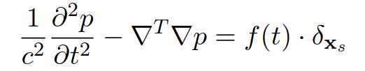
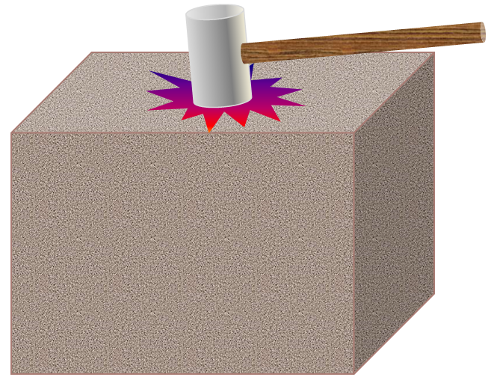
Seismic
acoustic wave equation for pressure p=p(t,x)
Propagation speed c
Source location x_{s}
Source amplitude speed f(t)

Slide 24
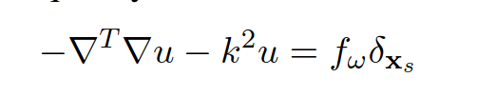
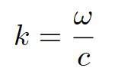
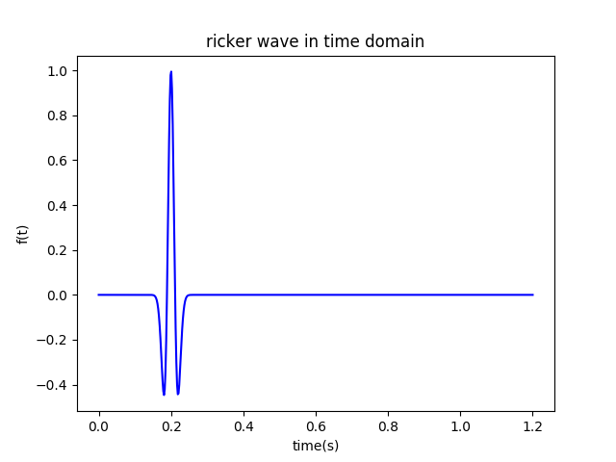
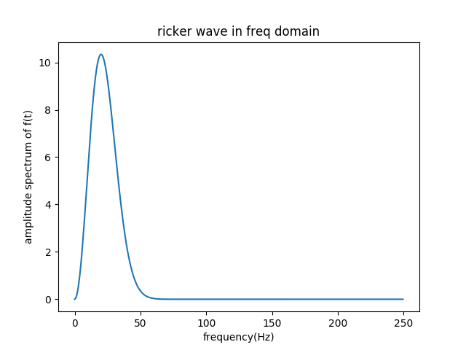
In Frequency Domain
Apply Fourier Transformation
  For any angular frequency ω :
Source amplitude speed f(t)
Source Spectrum speed f_{ω}

Slide 25

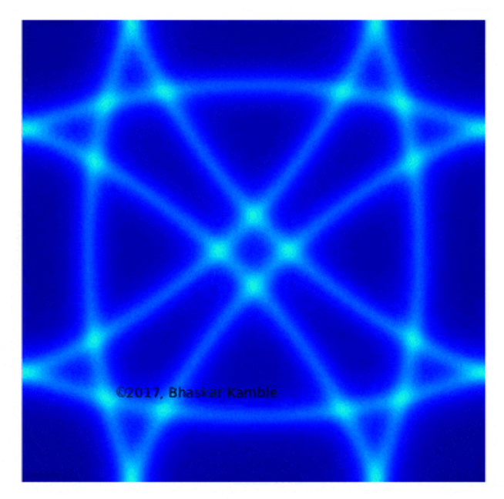

Where Are We?
Boundary conditions?
  For instance: u=0 on boundary
Wave equation in frequency fits
PDE template: A=I, D=-k²
But: reflection from boundary
  As domain is bounded
Introduce absorption
near boundary → eg. PML

Slide 26


PML
PML = Perfect Matching Layer
Apply a coordinate transformation:
With
  absorption strength parameter α
  absorbing functions Q_{i} : switches on/off absorption

Slide 27
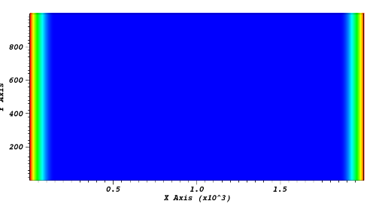
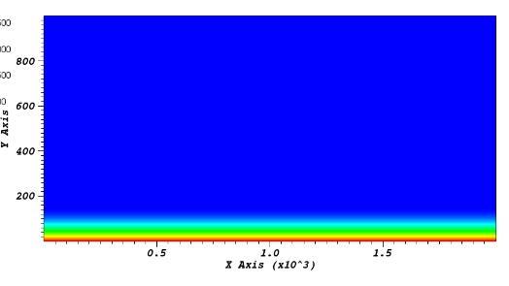
Absorbing Function
Red: Q_{i}=1, blue: Q_{i}=0
Horizontally: Q₀
Vertically: Q₁
source: x_{s}
Smooth transition
Switched on near boundary
Switched off in the interior

Slide 28

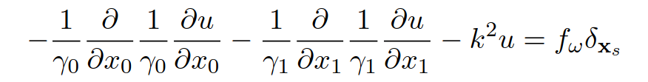

Wave Equation With PML
Does not fit PDE Template!!!!

Slide 29
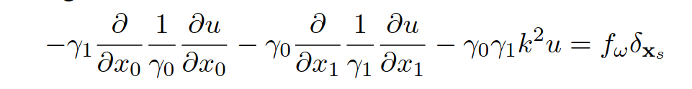
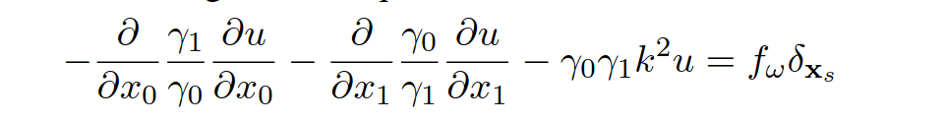

A Little Trick
Multiply by γ₀γ₁:
Notice: γ₁=γ₁(x₁) and γ₀=γ₀(x₀)
  Works also in 3D

Slide 30
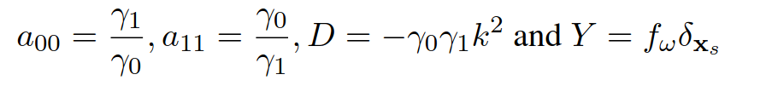
PDE Template
with Neumann boundary conditions

Slide 31
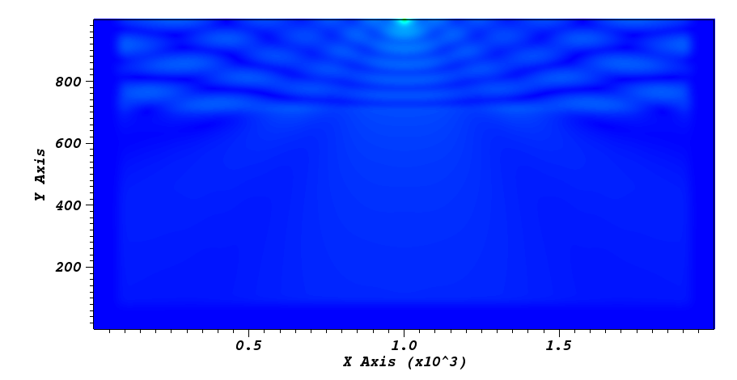
Example
Single reflector 2000m/s vs 3000m/s @ 300m
2000x1000 elements with edge length h=1
PML: α=0.5, layer thickness = 150m
Wave field u for 20Hz

Slide 32
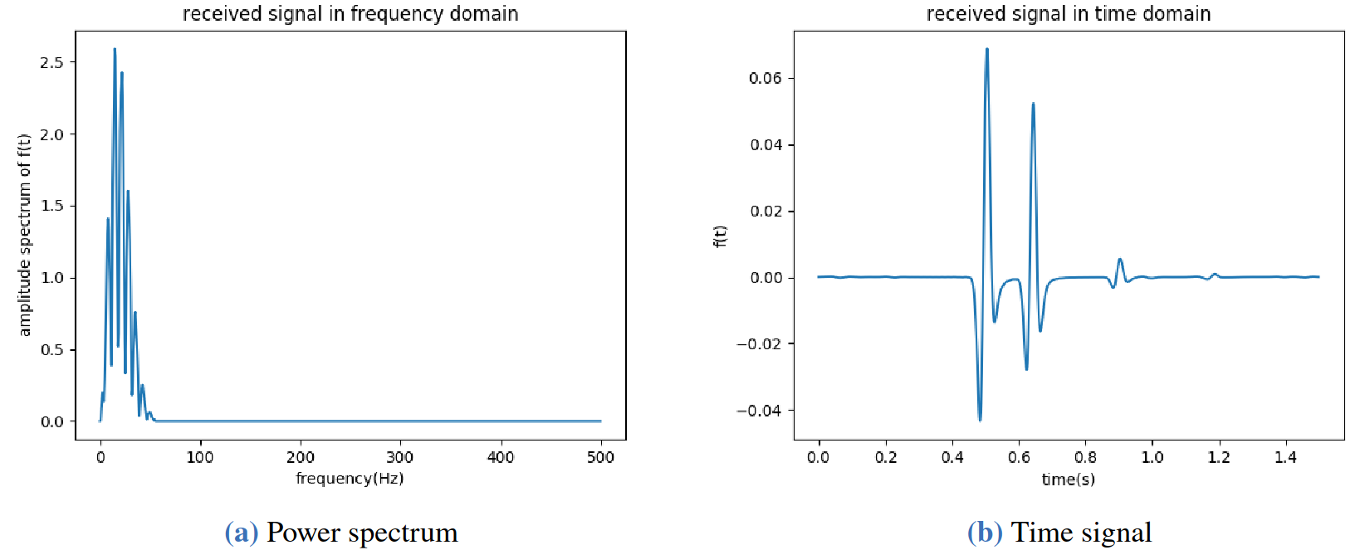
Example (cont.)
Recover signal at 500m off source
  Sampled at 1ms
  By Ao Chang using esys-escript

Slide 33
FEM solver for the PDE template
Follow what we did for gravity
  Define node and elements
    Element = connect vertices with nodes
  Define the local basis function N_{i}
    → linked to FEM basis ϕ_{p}^{h}
  Get Local Element matrices
    Evaluate PDE with local basis functions N_{i}
  Assemble local element matrices to linear system
  Insert Dirichlet conditions
  Solve the linear system of equations
→ Done
Here comes in the PDE template

Slide 34





PDE To Linear System
`strong` form of PDE:
For PDE template ?
`Weak` form of PDE:
Local element matrices:
Global system of linear equations:

Slide 35

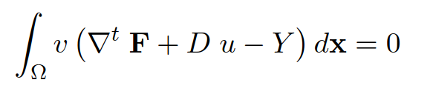
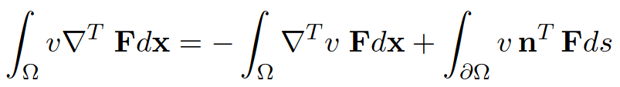
Weak Form PDE Template
Conservation law
Multiply by v and integrate:
Again: apply generalized Green’s first identity to pseudo-flux:
Boundary integral is zero as
  Neumann condition:
  Dirichlet boundary condition: where u=r → v=0

Slide 36
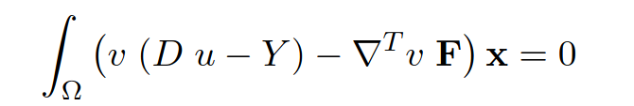

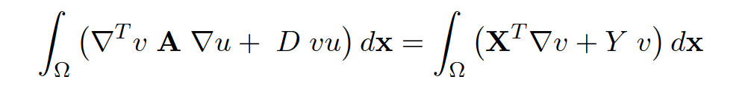
Weak Form PDE Template (cont.)
So we get:
Recall:
Finally: the ‘weak’ form of the PDE template

Slide 37
Weak Form PDE Template (cont.)
This is how it looks in the 2D case:
Next: break integration down to elements

Slide 38
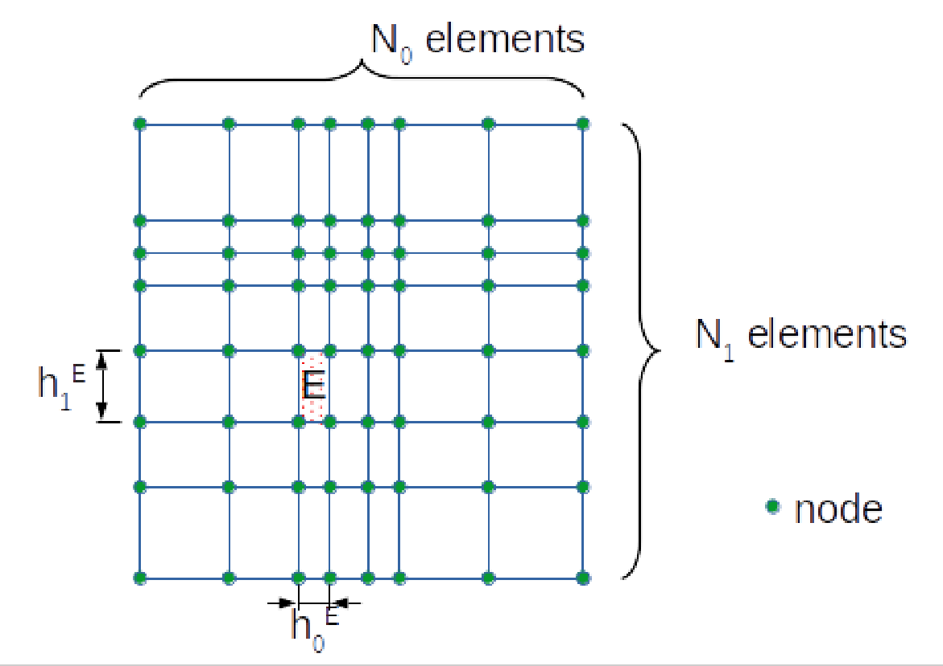
A More General Grid
Allow for rectangular shaped elements
Nodes are not are not equally spaced anymore
Element E is shape h₀E x h₁E.
and area A^{E}=h₀E h₁E

Slide 39
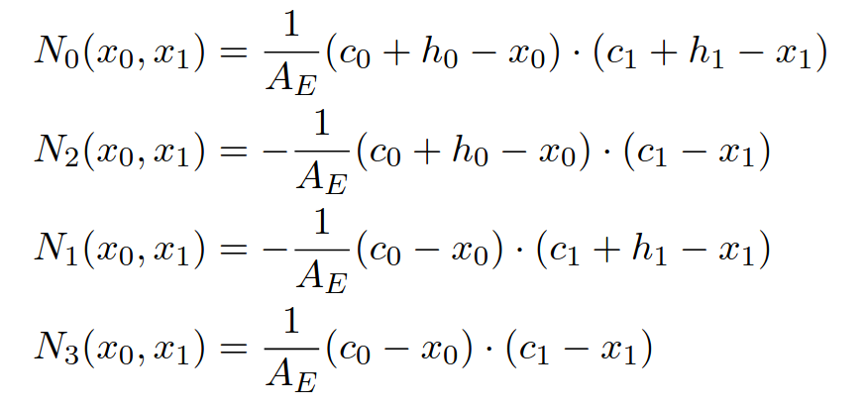
Modified local basis functions
Modifications relative to square case

Slide 40
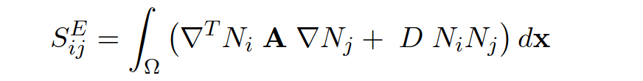
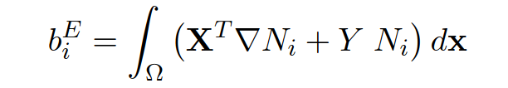
Local Element Matrices
This gives the local element matrices:

Slide 41
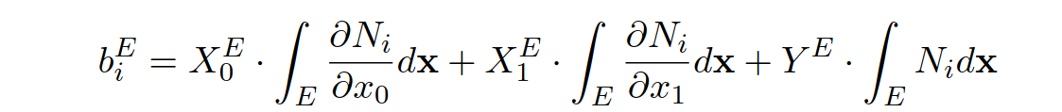
The 2D case
Assume: coefficients are constant at each element

Slide 42
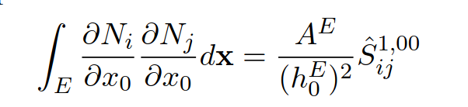
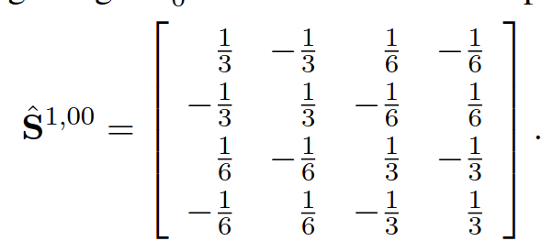
Evaluation
For instance:
For edge length h=1

Slide 43
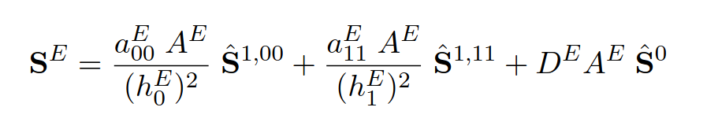
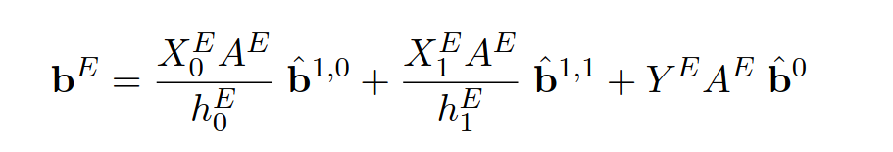
Element Matrix Calculation

Slide 44
Let’s take a closer look
Element geometry factors
PDE coefficient
For square element edge length h=1
Element geometry factors

Slide 45


Dirichlet-Type Boundary condition
When node q has a Dirichlet condition:
  overwrite row p with equation:
  And in right hand side

Slide 46
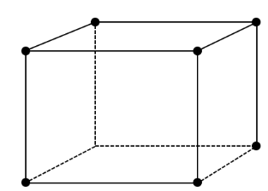

Extension into 3D
Now an element has 8 vertices = 8 FEM nodes
  Define link: element vertices → FEM nodes
  Define local basis N₀,...N₇
  Calculate

Slide 47

Anisotropy
PDE template with full coefficient matrix A:
  for instance modelling anisotropic conductivity
Introduces mixed derivatives of v and u in week form
An element level requires

Slide 48
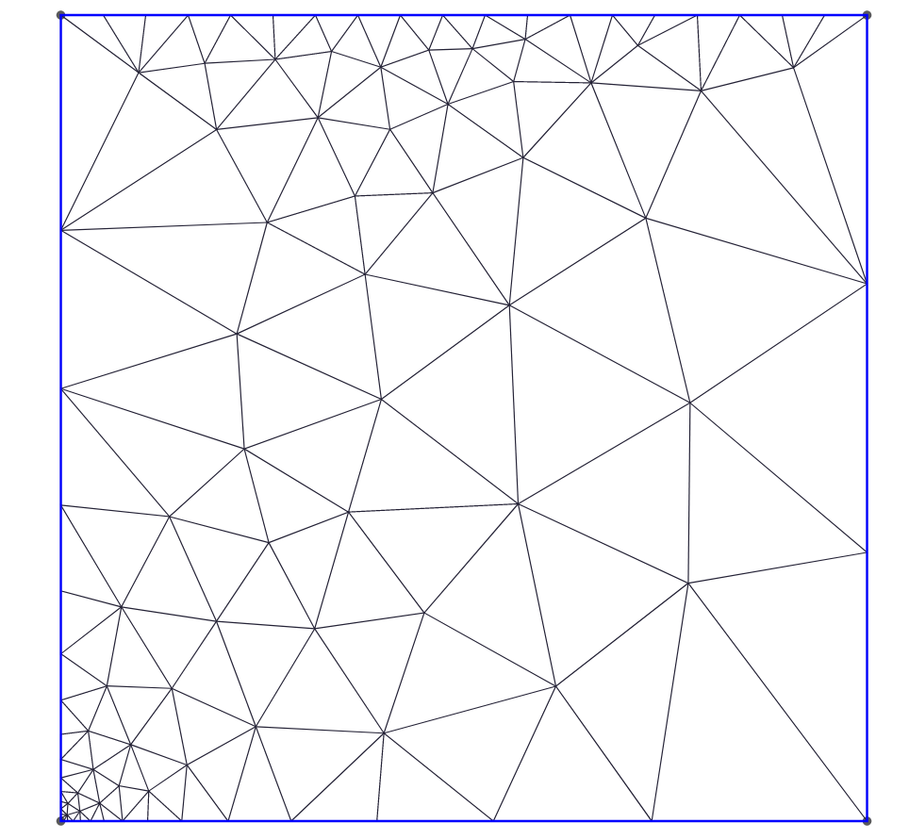
Other Element Shapes
For instance triangles or tetrahedrons
  Allows for local refinement
Modification analogously to 3D
  Construct local basis N₀,N₁,N₂
  Link Vertex → FEM node
  Element matrix calculation
    Not only stretching + rotation

Slide 49
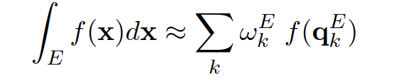

Numerical Integration
Assumption: PDE coefficient constant across element.
Better resolution of PDE coefficient on element?
Apply numerical integration on each element E:
  Integration nodes q_{k}^{E}
  Integration weights ω_{k}^{E}

Slide 50


Numerical Integration (Cont.)
Evaluate element matrices using numerical integration:
Warning: This requires more
memory and compute time.
PDE coefficient at integration points q_{k}^{E}
Element geometry factor
For edge length 1

